Slide 1

INTRODUCTION TO RESEARCH METHODS IN COMPUTER SCIENCE
Module I: Introduction
Instructor:
Michael Mutisya

Slide 2
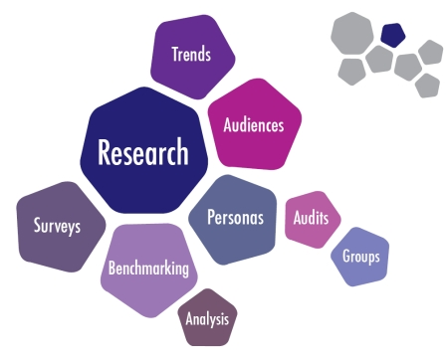
WHAT IS RESEARCH?

Slide 3
Class Exercise:
A teacher gives an assignment to her students to do some research in the library on great African leaders. For a period of one week one student goes to the library every day for 2 hours and reads up on Prof. Wangari Maathai. At the end of the week he says that he has learnt a lot about her.
Does this qualify as research? WHY?
What could this possible better be categorized as?

Slide 4
What is research?
The answer is: NO
Research IS NOT going to the library to get information or glean a few facts.
The teacher used the term ‘research’ loosely
What could this possible better be categorized as?
Information discovery
Learning library search skills

Slide 5
Defining research
Research IS: The systematic investigation into and study of materials and sources in order to establish facts, analyse data, and reach new conclusions within the parameters of a scientific method
To describe, explain, predict and control the observed phenomenon
Therefore:
The key product of research is INFORMATION
The main processes of research are SEARCH, REVIEW, EVALUATE & INTERPRET
The processes have to be SYSTEMATIC & METHODICAL
Research IS NOT: Randomly selecting books from the library or surfing the internet; it is also not merely collecting data, collating it and sharing it
Further reading:
“Practical Research Planning and Design”, by Paul D Leedy, Chap1: What Is Research

Slide 6
Defining research
Research is an ORGANIZED and SYSTEMATIC way of FINDING ANSWERS to QUESTIONS.
SYSTEMATIC because there is a definite set of procedures and steps which you will follow. There are certain things in the research process which are always done in order to get the most accurate results.
ORGANIZED in that there is a structure or method in going about doing research. It is a planned procedure, not a spontaneous one. It is focused and limited to a specific scope.
FINDING ANSWERS is the end of all research. Whether it is the answer to a hypothesis or even a simple question, research is successful when we find answers. Sometimes the answer is no, but it is still an answer.
QUESTIONS are central to research. If there is no question, then the answer is of no use. Research is focused on relevant, useful, and important questions. Without a question, research has no focus, drive, or purpose

Slide 7
Reasons for doing Research
To add to the body of knowledge
To solve a problem
To find out what happens
Eg What happens when a new computer system is put into real-world
To develop a greater understanding of people and their world
To predict, plan and control
Computer-based systems can provide tools to help people predict, plan and control.
To contribute to other people’s well-being
- make life better for other people. Eg . can we research and design better user interfaces so some people, such as older people or disabled people, do not have to struggle when using GUI

Slide 8
Reasons for doing Research
To test or disprove a theory
To come up with a better way
A new or improved product
A new theory
A re-interpretation of an existing theory
New or improved research tool or technique
A new or improved model or perspective
An in-depth study of a particular situation
An exploration of a topic, area or field
new or improved evidence;
new or improved methodology;
new or improved analysis;
new or improved concepts or theories.
new or improved computer-based product.

Slide 9
Theory:
Relationship between Research and Theory
Research “must” be grounded in theory
There are a wide range of theories available
We use theories as a means of explaining our research
We can also carry out research that challenges existing theories or to develop new theories
What Theory Help us to
Understand
Explain
Predict
Analyse and
Design actions
about a phenomena
What Makes a Good Theory?
Validity
It fits the facts
Generalization
Makes Prediction about the future
Replication
Can be repeated with similar results

Slide 10
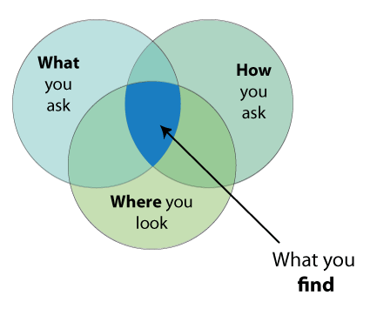
What research entails
Research need / purpose
Overall goal and objectives
Research design
Research questions
Information areas
Research approach
Sampling
Data collection instruments
Preparing for fieldwork
Fieldwork / data collection
Data entry and analysis
Report writing
Dissemination of findings

Slide 11
Identify the broad area of study
Draw Conclusions
Evaluate Results
What are limitations of the conclusions?
LR
Select a research topic
1. What do we want to achieve
4. Have we achieved what we set out to do?
Write Research Report
Define Research Problem
2. How do we achieve it?
3. What do we do with the data?
Develop Theoretical Framework /Hypothesis
Design Research
Conduct Research
Analyze and interpret the data
Plan how you will perform the research
What type of research
What approach to research?
What research instruments will I use?
Design the instruments
Which data analysis techniques to use?
Gather data
Research Process

Slide 12
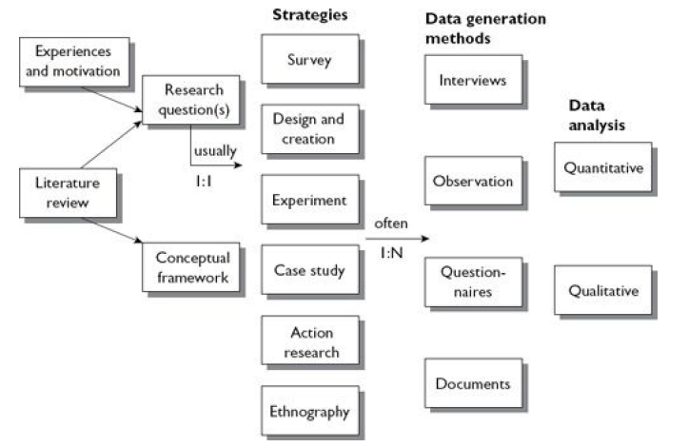
Model of the research process

Slide 13
Finding and Choosing Research Topics
Sometimes they emerge out of personal circumstances and opportunities.
Suggestions from staff in your department/colleague.
Recent conference and journal papers
Brainstorming and clustering
Selecting a topic
Topic should best meet two criteria of enjoyability (for you) and feasibility (as a piece of academic research).
Will I enjoy working on that topic?’
Try to express each potential topic as a single research question.
Now break down what you would need to do to address that question, expressing it as series of objectives you would have to meet

Slide 14
Selecting a topic
About the feasibility, ask yourself the following questions:
Is the research likely to offer something new for your target users?
Is the research and its outcomes likely to be of sufficient scope to meet your course requirements?
Can the research be carried out in the time available?
Does the research topic fit in with your own motivations, strengths and weaknesses, likes and dislikes?
Does the research meet your own learning objectives?
Do you have the necessary resources?
Can you approach the topic without too much bias?
Will the research be safe and ethical?

Slide 15
Class Exercise:
What does it mean to have a researcher mindset?
How does a researcher think?
How do they behave?
How do they act or react?

Slide 16
The researcher mindset – 1/3
KEEPS EYES OPEN; HIGHLY AWARE OF SURROUNDINGS AND HAPPENINGS
QUESTIONING MIND; CURIOUS
CRITICAL THINKER / ANALYZER
PROBLEM SOLVER
THINKS BEYOND THE BOX
LEARNS FROM OTHER PEOPLE; HAS URGE TO LEARN MORE
UP TO DATE WITH KNOWLEDGE AND THE WORLD; CURRENT AFFAIRS

Slide 17
The researcher mindset – 2/3
ENQUIRES ABOUT CURRENT WORLD SO AS TO DETERMINE FUTURE NEEDS
ABLE TO IDENTIFY NEEDS
OBJECTIVE; NEUTRAL; OPEN MINDED
EMPATHETIC, COMPASSIONATE, (ABILITY TO PUT ONESELF IN OTHER PEOPLE’S SHOES)

Slide 18
The researcher mindset – 3/3
SEEKS TO VERIFY RESULTS OR INFORMATION; URGE FOR THE TRUTH
DOESN’T FEAR FAILURE; RISK TAKER; FAILS GLORIOUSLY
PUSHES THE FRONTIER, NOT SATISFIED WITH CURRENT STATE OF THE WORLD
BELIEVES IN SOCIAL JUSTICE; WANTS TO MAKE THE WORLD A BETTER PLACE

Slide 19
Strategies
A strategy is your overall approach to answering your research question
Survey: focuses on obtaining the same kinds of data from a large group of people
(or events), in a standardized and systematic way.
You then look for patterns in the data using statistics so that you can generalize to a larger population than the group you targeted.
Design and creation: focuses on developing new IT products.
Experiment: focuses on investigating cause and effect relationships, testing hypotheses and seeking to prove or disprove a causal link between a factor and an observed outcome.
Case study: focuses on one instance of the ‘thing’ that is to be investigated: an organization, a department, an information system etc,
Action research: focuses on research into action. The researchers plan to do something in a real-world situation, do it, and then reflect on what happened or was learnt, and then begin another cycle of plan–act–reflect.
Ethnography: focuses on understanding the culture and ways of seeing of a particular
group of people.

Slide 20
Data Generation methods
Interview: a particular kind of conversation between people where, at least at the beginning of the interview if not all the way through, the researcher controls both the agenda and the proceedings and will ask most of the questions.
Observations: watching and paying attention to what people actually do, rather than what they report they do. Often involves looking, but it can involve the other senses too: hearing, smelling, touching and tasting.
Questionnaire: a pre-defined set of questions assembled in a pre-determined order. Respondents are asked to answer the questions, often via multiple choice options,
Documents: documents that already exist prior to the research (for example, policy documents, minutes of meetings and job descriptions)

Slide 21
Classifying Research- 1/2
Research can be classified by:
FIELD: A labelling device that enables groups of researchers with similar interests to be identified e.g. ‘Natural language engineering’
APPROACH: Research methods applied as part of the research process e.g. case study, simulation, survey, experiment… or the methods chosen e.g. ‘Natural language engineering using machine learning approaches.’
NATURE: The type of contribution made to knowledge.
Pure theory: developing theories to explain things without necessarily linking them to practice. Use inductive reasoning to make personal conclusions and theories.

Slide 22
Classifying Research -2/2
Descriptive studies: reviewing and evaluating existing theory and knowledge in a field or describing particular situations or events. Might including testing existing theories, describing state of the art, or looking for limits in previous generalizations.
Exploratory studies: exploring a situation or a problem. Seeking new insights, information and ideas; asking questions; assessing a phenomena in a new light. Suitable methodologies include literature studies, open questionnaires and interview. Process is iterative.
Explanatory studies: explaining or clarifying some phenomena; identifying the relationships between things.
Causal studies: assessing the effects that one or more (independent) variables have on another (dependent) variable. Influence of extraneous factors must be eliminated / catered for.

Slide 23
Assignment: Types of research
Outline the broad categories of research:

